Slide 1
Web programming project: E-CommerCe website
Supervisor: TS. Dao Thanh Chung
Member’s list:
Tran Thai Phuc - 20184300
Vu Tung Lam - 20184283
Notes:
Lydia

Slide 2
Outline
Introduction
Design Process
Main Functions
Work Contribution
Conclusion
Notes:
Lydia

Slide 3
Introduction
Why do we choose E-commerce website?
Some major function
Techniques:
Backend: Nodejs, ExpressJs, Axios
Frontend: HTML, CSS, JavaScript, template EJS
Database: MySQL
Pattern: MVC

Slide 4
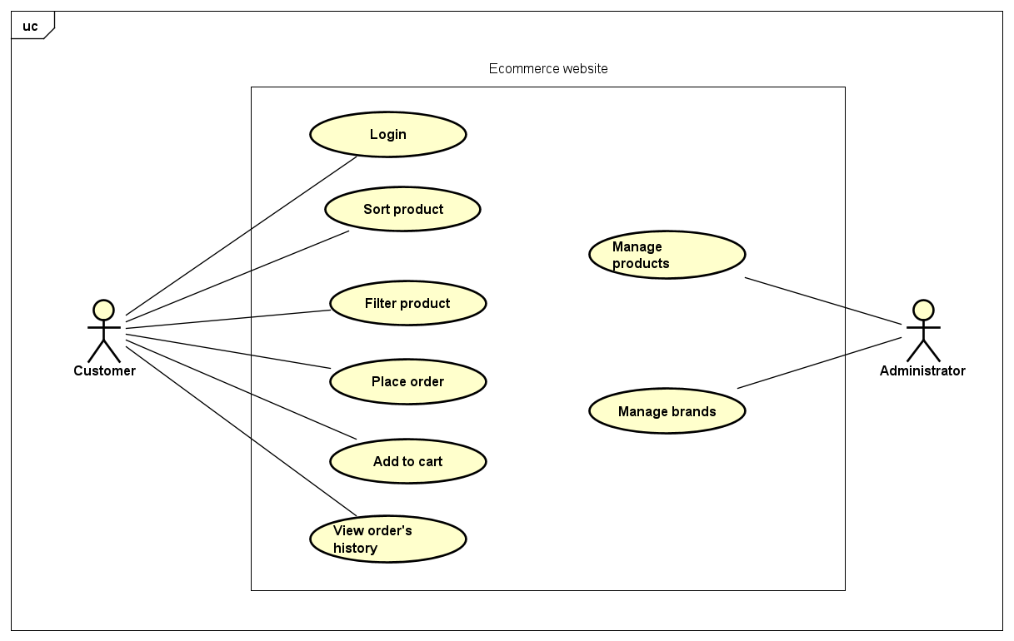
Design Process
Usecase diagram
Notes:
Lauren

Slide 5
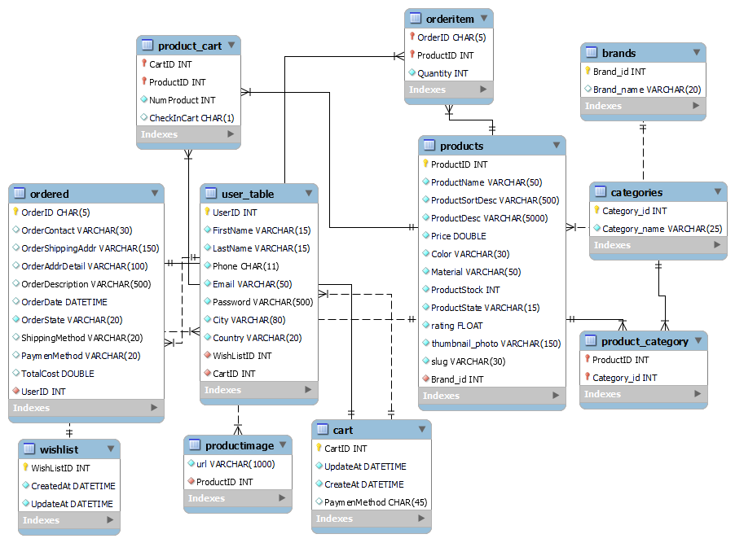
Design Process
Relationship diagram
Notes:
Lauren

Slide 6
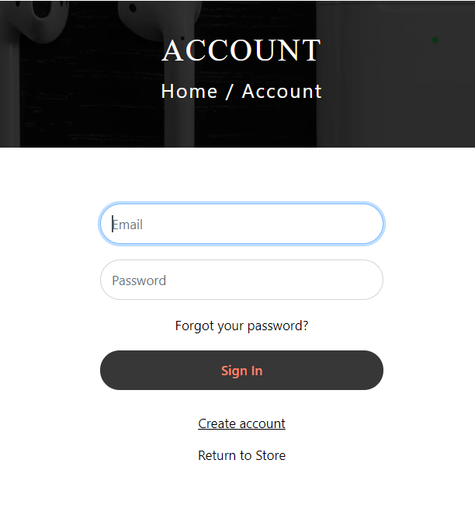
Main Functions
Login/Register page
Notes:
Lauren

Slide 7

Main Functions
Product pages
(home page)
Notes:
Lauren

Slide 8
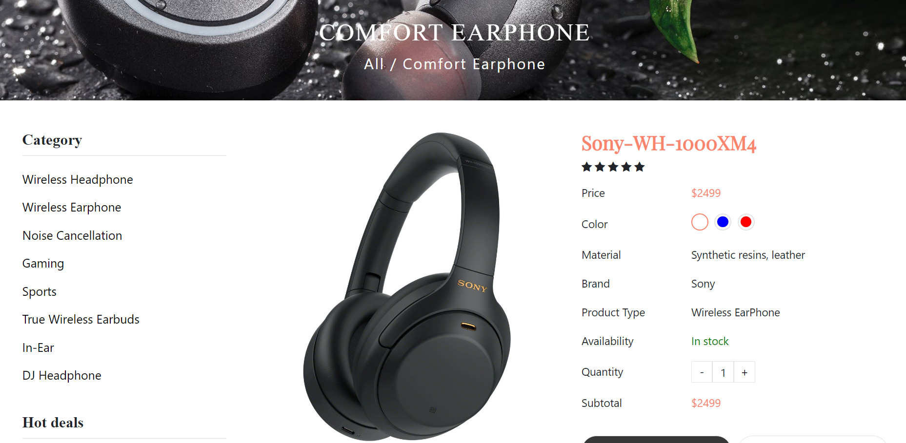
Main Functions
Product’s detail page
Notes:
Lauren

Slide 9
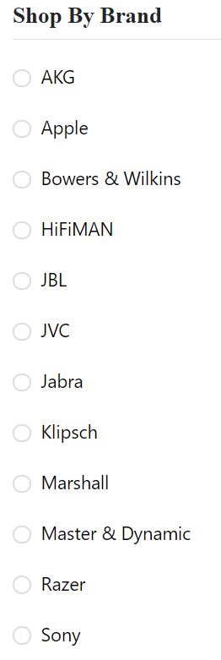
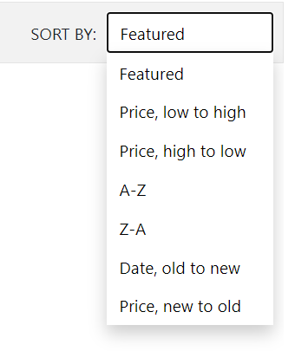
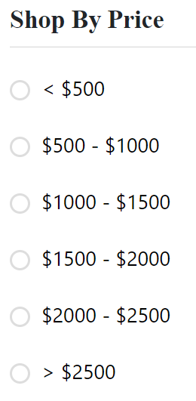
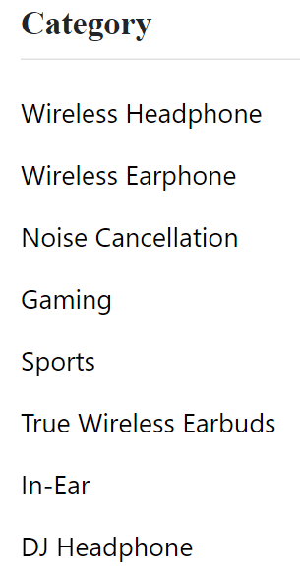
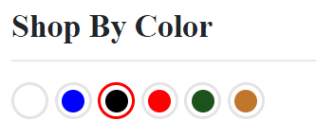
Main Functions
User can sort or filter products by brands, price, promotion, rating
Notes:
Lauren

Slide 10
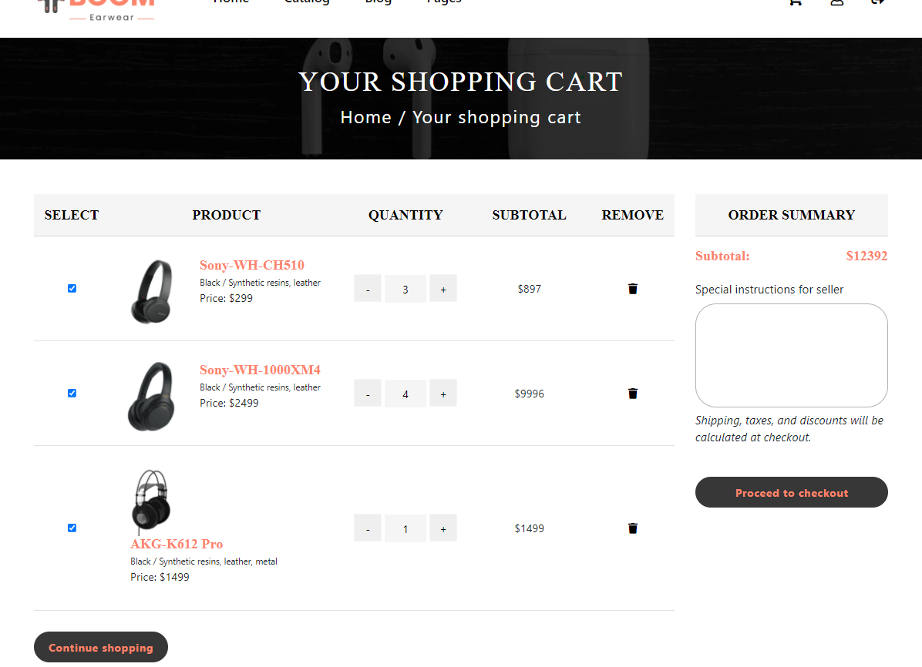
Main Functions
User can view their cart and place the order
Notes:
Lauren

Slide 11
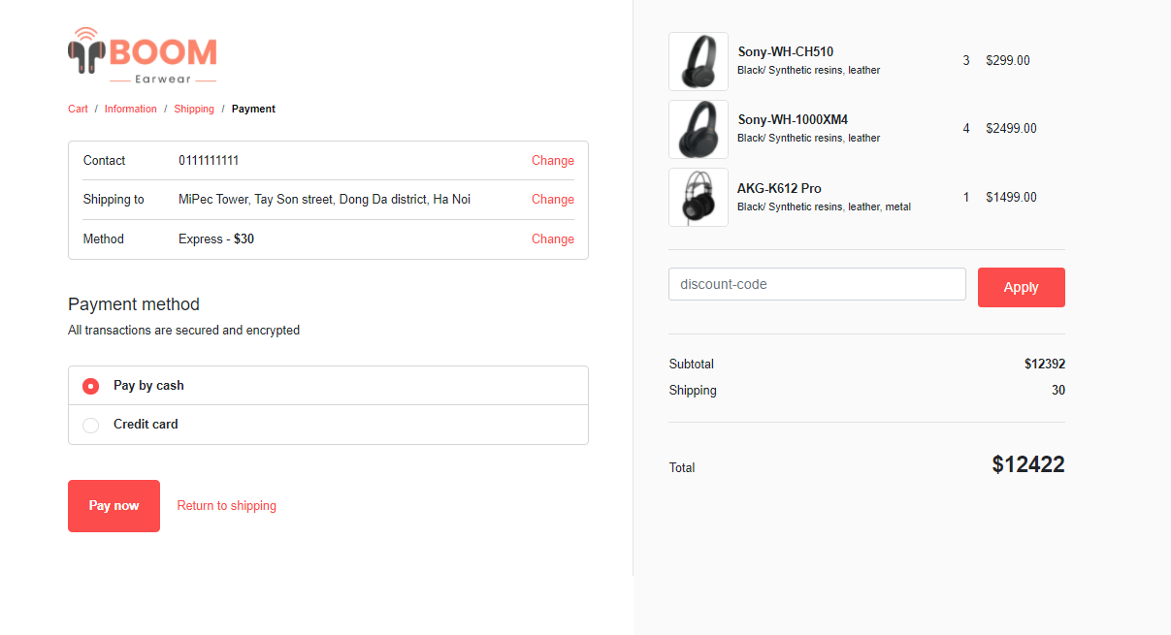
Main Functions
Then, user must fill the payment’s information to finish their purchase
Notes:
Lauren

Slide 12
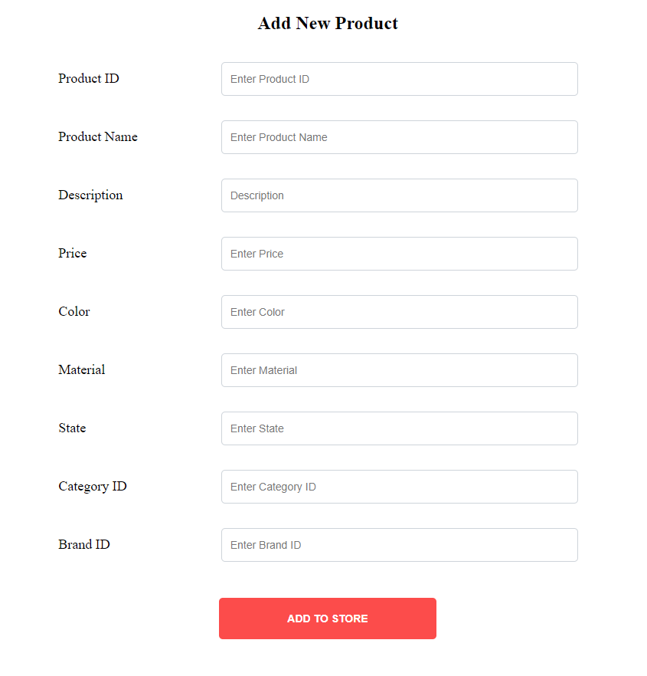
Administrator’s Functions
Admin can mange all products of the store
Notes:
Lauren

Slide 13
Work Contribution
Tran Thai Phuc – 20184300
Design database, slides
Draw usecase diagram, relationship diagram
Develop backend site
Vu Tung Lam – 20184283
Design database, slides
Draw usecase diagram, relationship diagram
Develop frontend site
Notes:
Lauren

Slide 14


